Slide 2
How many properties we have used in @NgModule decorator?
How many properties we have used in @Component decorator?

Slide 3
Change detection

Slide 4
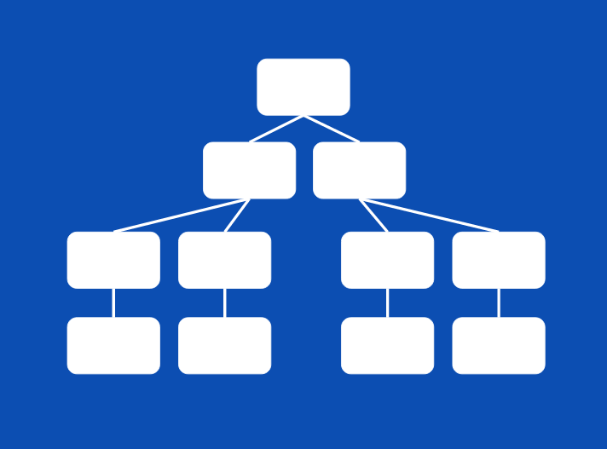

Slide 5
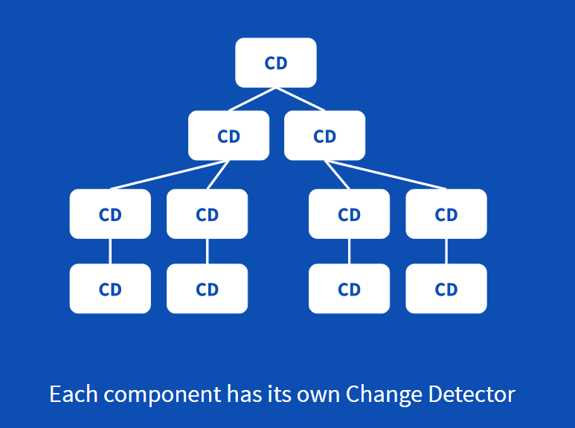

Slide 6
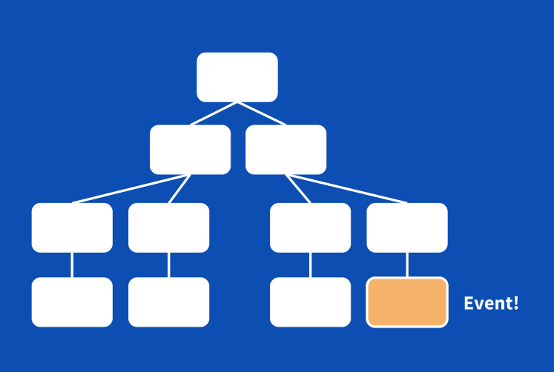

Slide 7
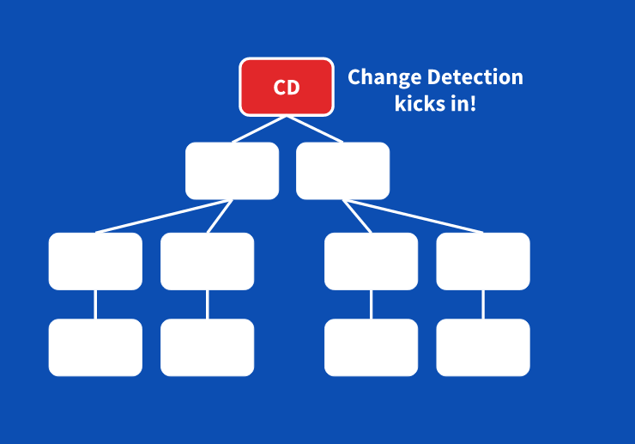

Slide 8
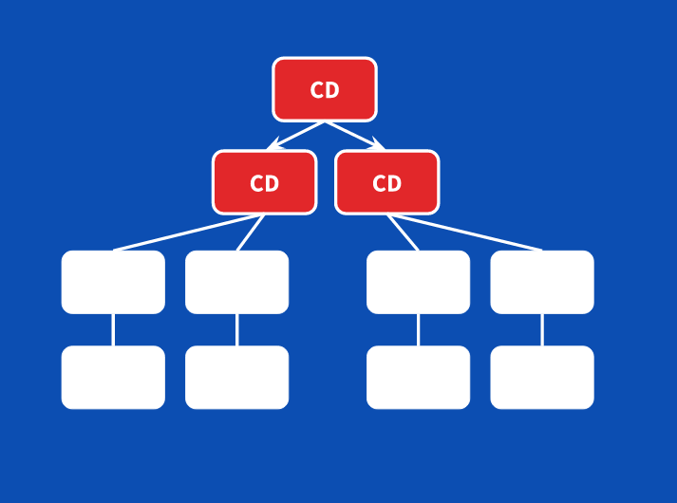

Slide 9
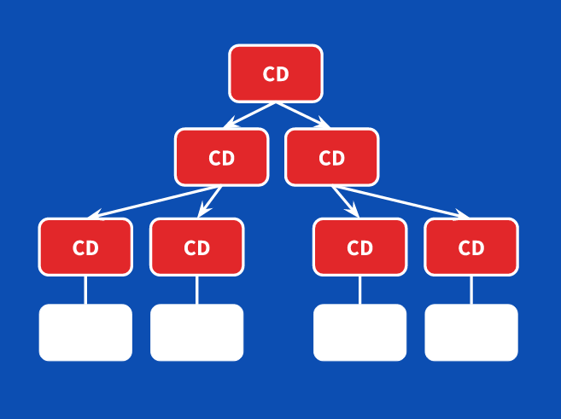

Slide 10
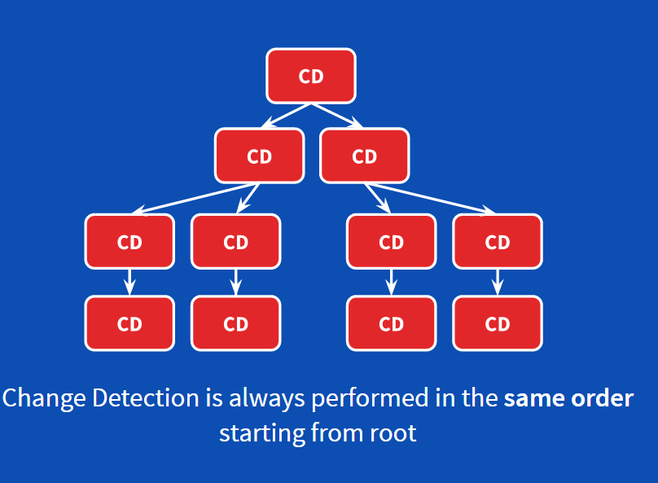

Slide 11


Slide 12
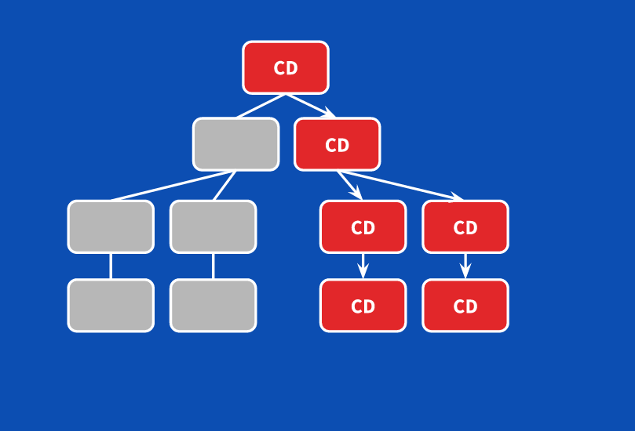

Slide 13
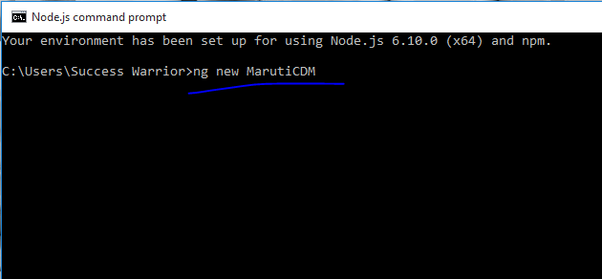

Slide 14
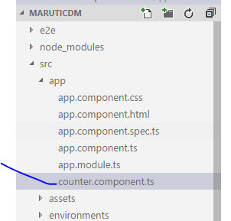

Slide 15
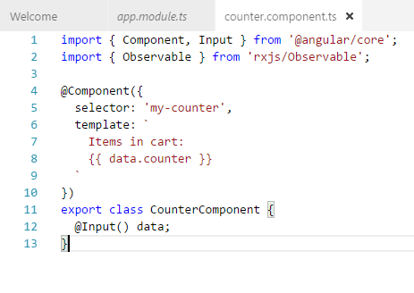

Slide 16
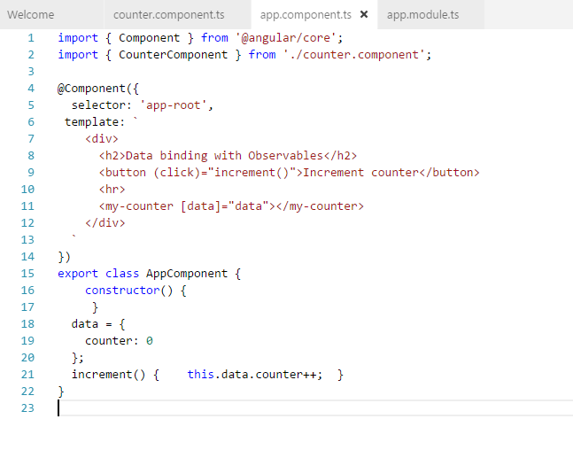

Slide 17
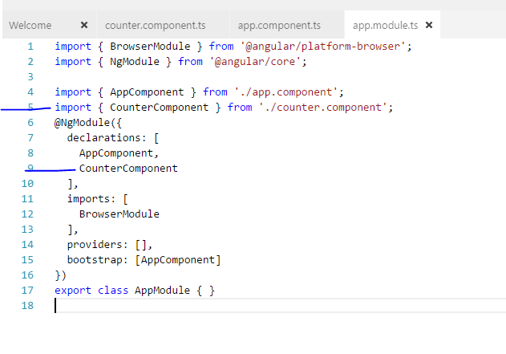

Slide 18
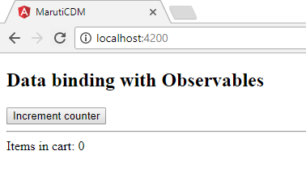
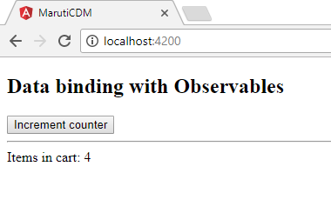

Slide 19
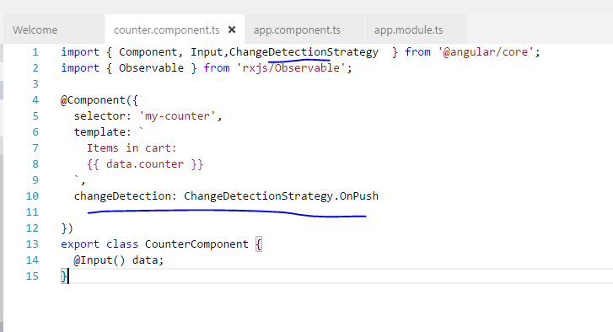

Slide 20
Components-300
Modules -4
user
Calculation-110
Reports-80
Imports-75

Slide 21
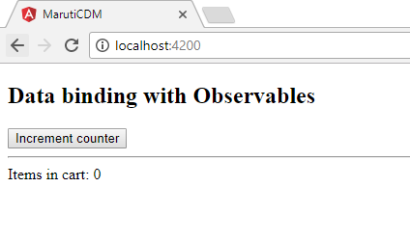
After adding this line counter will not work because
OnPush is a chnage detection strategy which only perform
change detection when reference of this input data change
and not if property within the data change.

Slide 22
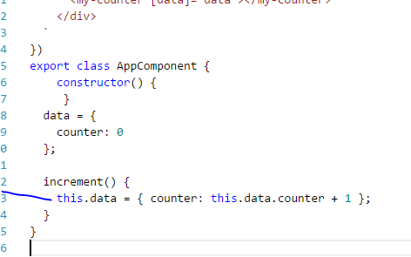
Now change the logic of increment function

Slide 23
now to make this thing working change increment function logic to this
increment() { this.data = { counter: this.data.counter + 1 }; }
because now inside increment function we have new object reference which is not going to be equals to previous one this will detect changes

Slide 24
Started working !!

Slide 25
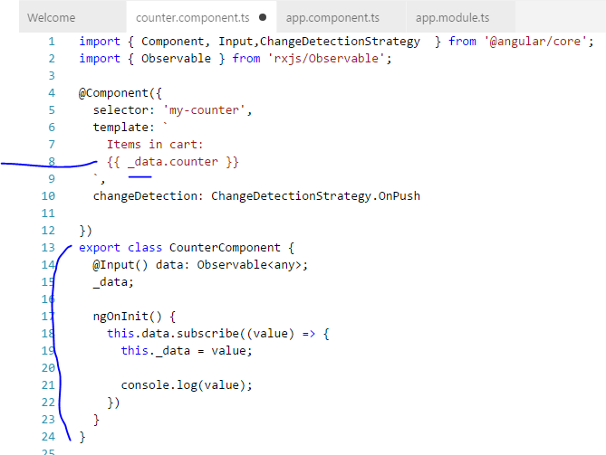
Instead of passing data directly
now we are making it
Observable

Slide 26
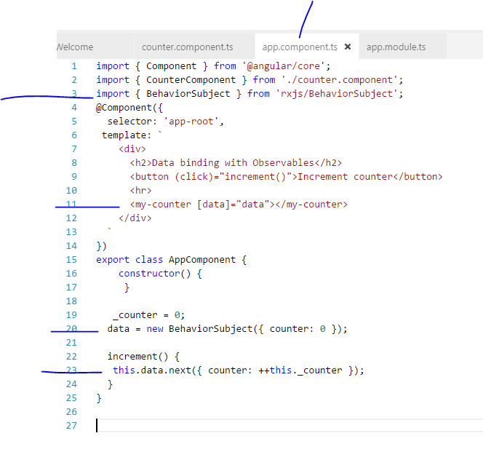

Slide 27
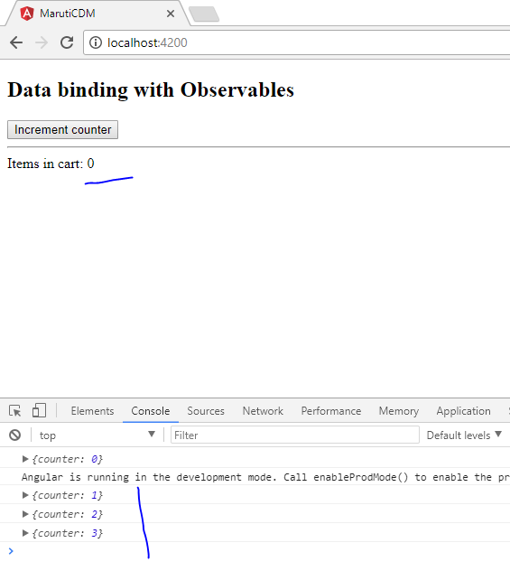
Value increment is working but
Its not showing in UI

Slide 28
1- simple incre
2-CDS-on push
3-observables
4-cd service MFC
5-changes - freq

Slide 29
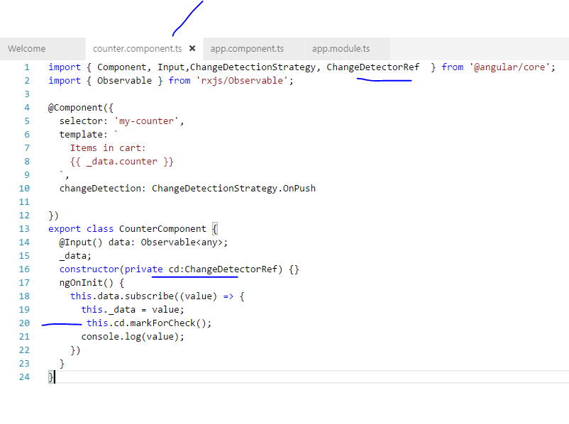

Slide 30
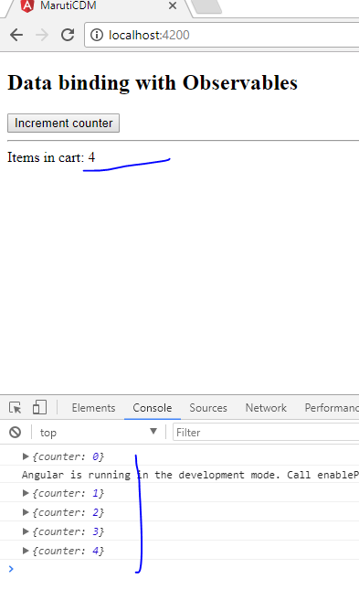
Now working because we Marked for check

Slide 31
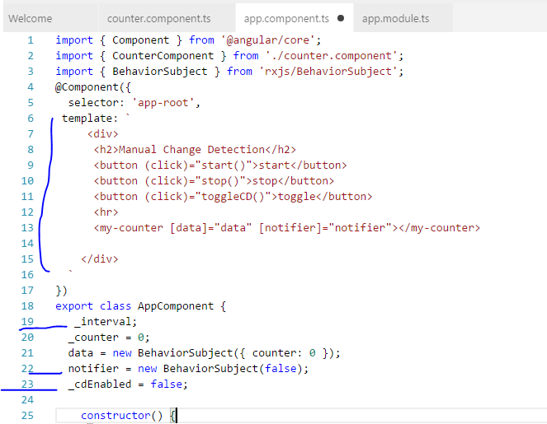

Slide 32
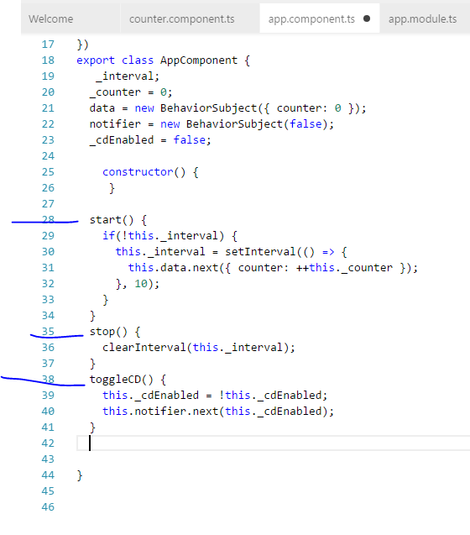

Slide 33
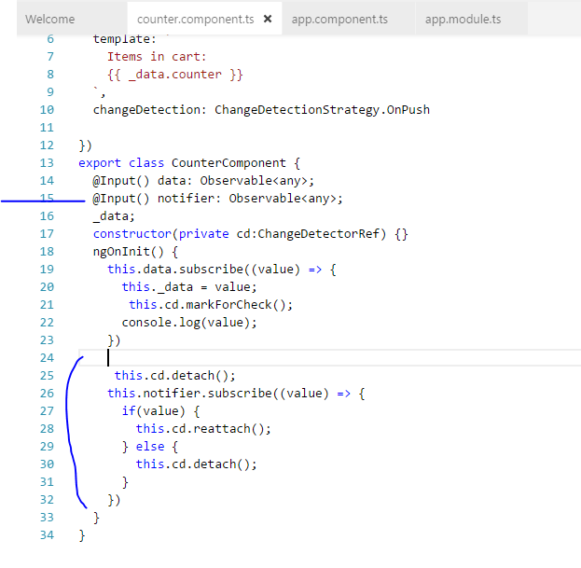
When we want to attach and detach
Change detection for particular node

Slide 34
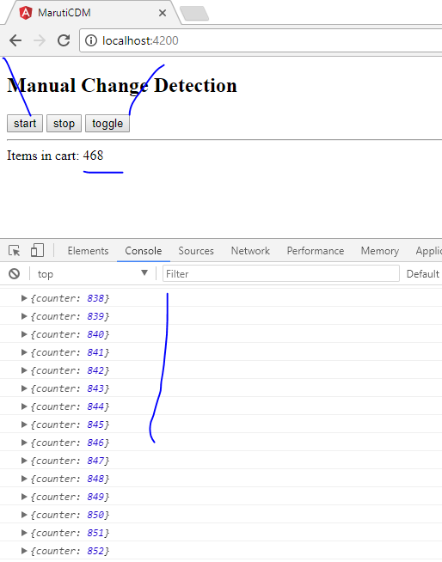

Slide 37
Immutable Objects
Open this link in firefox browser
https://plnkr.co/edit/G1QH0ZEML6bXm95bhC1J

Slide 38
Change increment logic from
increment() { this.data = { counter: this.data.counter + 1 }; }
to
increment() { this.data.counter++; }

Slide 39
and then remove this line from counter.component
, changeDetection: ChangeDetectionStrategy.OnPush
you can check incerement will work fine

Slide 40
but now if you add above line in @component decorator
, changeDetection: ChangeDetectionStrategy.OnPush
then this will stop incementing it because
OnPush is a chnage detection strategy which only perform
change detection when reference of this input data change
and not if property within the data change.

Slide 41
now to make this thing working change increment function logic to this
increment() { this.data = { counter: this.data.counter + 1 }; }
because now inside increment function we have new object reference which is not going to be equals to previous one this will detect changes

Slide 42
Observables
Open this link NOW
https://plnkr.co/edit/TLi6Us5CDz6yGWV4k34Y

Slide 43
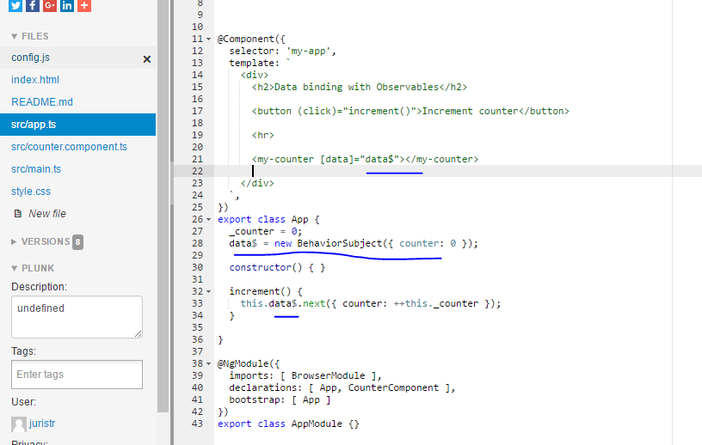
If you compare this sample with previous one then
Instead of passing data directly
now we are passing through
observables

Slide 44
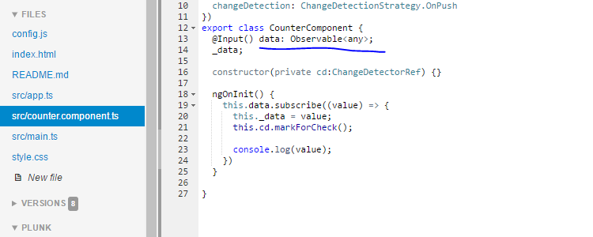
Data is not observable and coming from somewhere else

Slide 45
In this case Change detection will not work directly because of observables
That’s why you need to use ChangeDetectorRef so that this should work.

Slide 46
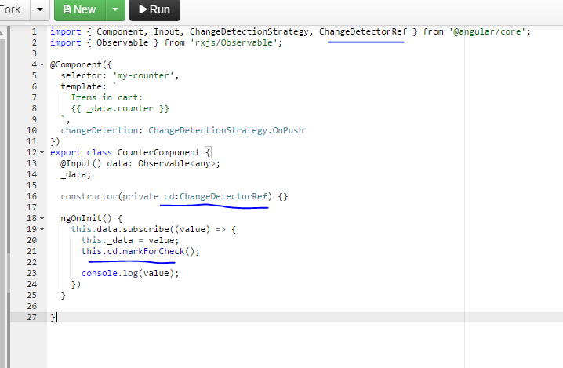
So we are manually calling change detection
If you remove this then it wont work

Slide 47
Manually handling change Detection
Open this link
https://plnkr.co/edit/5OM0A53GlHyWWyam4TRA

Slide 48
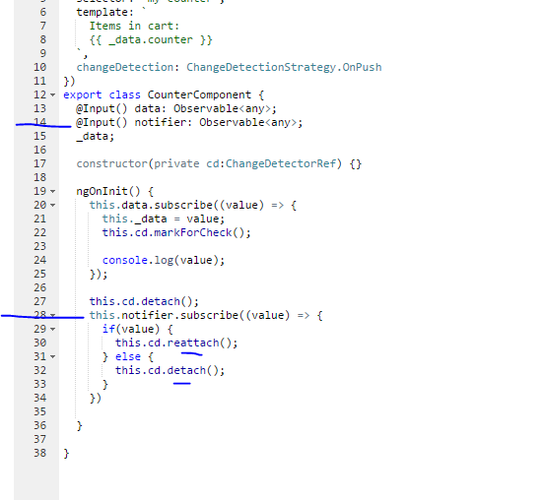
When we want to attach and detach
Change detection for particular node

Slide 49
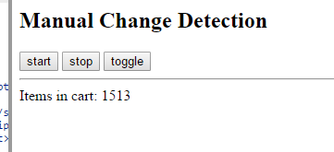
When we want to attach and detach Change detection for particular node
Click on toggle and then start
After that when you click on toggle again this will stop detecting and
On next click this will show you higher value because that was running in bacground

